Slide 1
Module 1
Introduction to Computer Networking

Slide 2
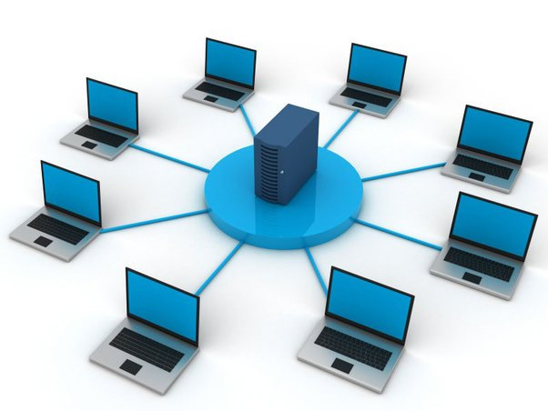
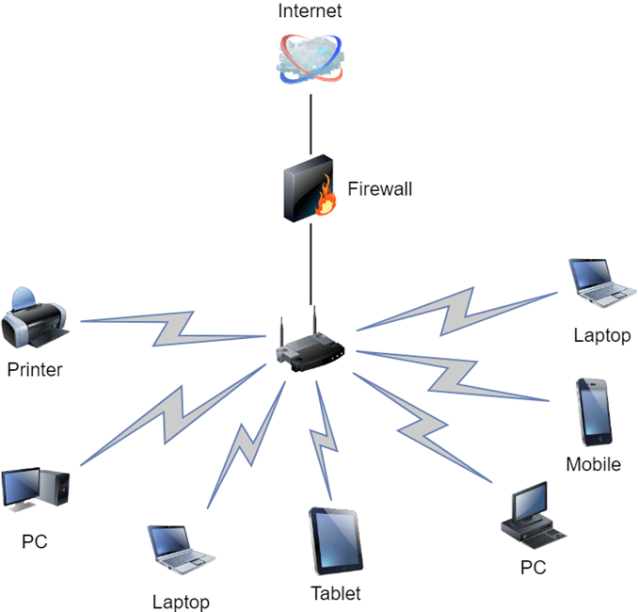
What is Computer Networking?
refers to interconnected computing devices that can exchange data and share resources with each other.
These networked devices use a system of rules, called communications protocols, to transmit information over physical or wireless technologies.

Slide 3
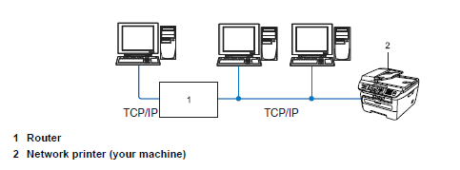
Goals of computer network
To share data and resources

Slide 4
Classification of Networks
Computer Networks are classified based on the various factors.
Geographical Span
Inter-Connectivity
Administration
Architecture

Slide 5
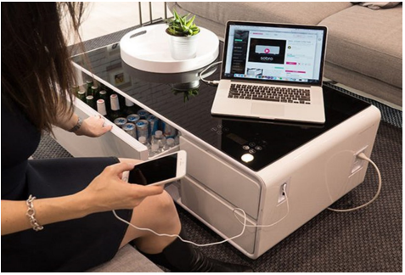

Geographical Span
It pertains to a certain area or place.
Geographical span can be seen in these categories
  It may be spanned across you table, among Bluetooth enabled device ranging not more than few meters.

Slide 6
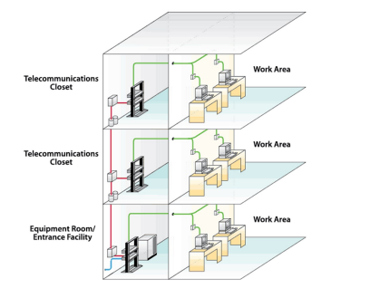
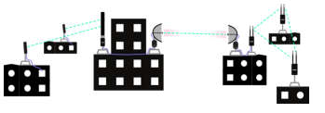
Geographical Span
It may be spanned across a whole building, including intermediate devices to connect all floors.

Slide 7
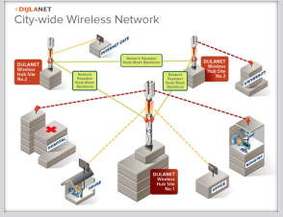
Geographical Span
It may be spanned across a whole city.

Slide 8
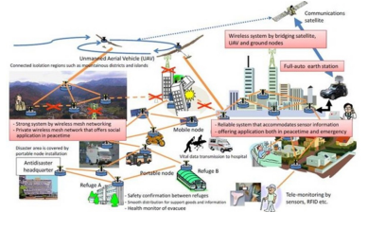

Geographical Span
It may be spanned across multiple cities or provinces.

Slide 9
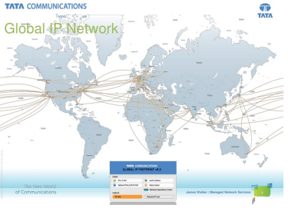
Geographical Span
It may be one network covering the whole world.

Slide 10
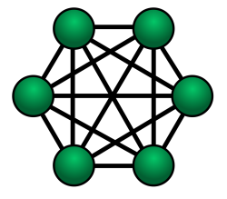
Inter-connectivity
When we say “inter-connectivity,” it pertains to how they are connected to each other.
  Components of network can be connected to each other differently in some fashion, such as:
    Every single device can be connected to every other device on network, making the network mesh.

Slide 11
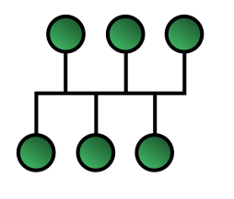
Inter-connectivity
All devices can be connected to a single medium, created bus-like structure.

Slide 12
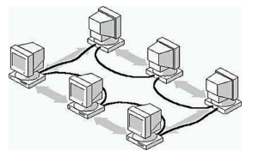
Inter-connectivity
Each device is connected to its left and right peers only, creating linear structure.

Slide 13
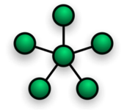
Inter-connectivity
All devices connected together with a single device, creating star-like structure.

Slide 14
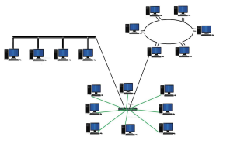
Inter-connectivity
All devices connected arbitrarily using all previous ways to connect each other, resulting in a hybrid structure.

Slide 15
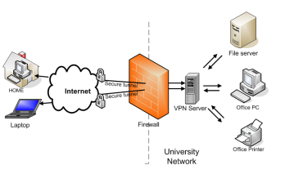
Administration
A network can be a private network which belongs a single autonomous system and cannot be accessed outside its physical or logical domain.
A network can be a public network, which is accessed by all.

Slide 16
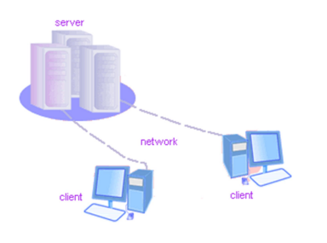
Architecture
Computer networks can be discriminated into various types such as Client-Server, peer-to-peer or hybrid, depending upon its architecture.
    There can be one or more systems acting as Server. Other being Client that requests the Server to serve request.

Slide 17
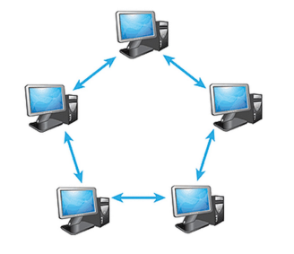
Architecture
Two systems can be connected point-to-Point, or in back-to-back fashion

Slide 18
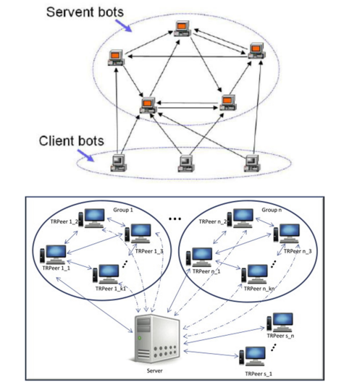
Architecture
There can be hybrid network which involves network architecture of both the aforementioned types.

Slide 19
Thank You!

